Slide 1
Evolution of Complex Systems
Lecture 4: Cells and genome
Peter Andras peter.andras.ncl@gmail.com
2022 Edition

Slide 2
Objectives
The cell system
The language of the cell
Memories in the cell: RNA and DNA
Genome = information subsystem of the cell
The genome system
Identity of the cell
Identity violation and adaptation in the cell
Cell and genome complexity

Slide 3
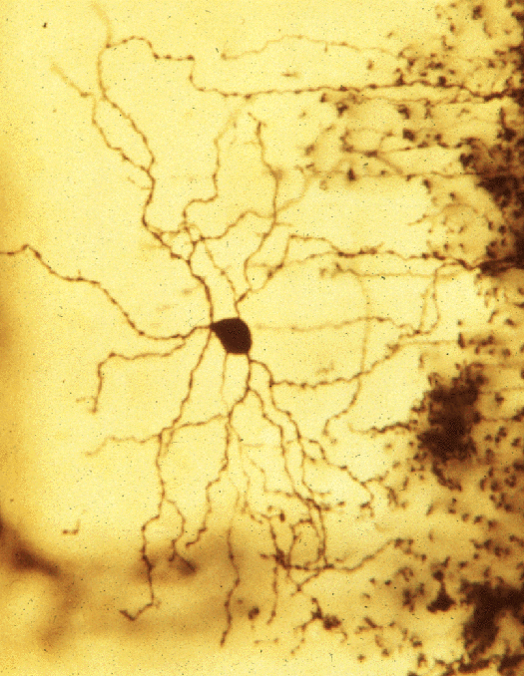
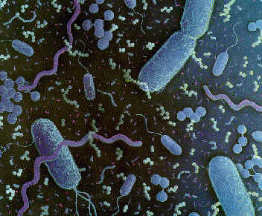
Cells
Bacteria, plant and animal cells – constituents of tissues
E.g., neuron, muscle cell etc.

Slide 4
Cell structure

Slide 5
Cell wall and membrane
Delimiting from the exterior
Defines outer form
Semi-permeable structure composed of lipo – protein complexes

Slide 6
Cytoplasm and cellular organelles
Cytoplasm: solution of proteins and metabolites organised in membranes and intra-cellular matrix
Cellular organelles: perform various functions (cellular motion, secretion, digestion, etc.)

Slide 7
The nucleus
DNA, chromatin, RNA
Contains the code describing cell components
Genes code proteins
Adenin – A, Cytosin – C, Guanin – G, Thymin – T
DNA: organised in genes and non-coding segments

Slide 8
Cell behaviour
Selection of resources: channels, diffusion, fagocitosis
Digestion
Generation of new proteins the main building blocks of the cell
Multiplication: self-replication
Self-defence: secretion of self-defensive proteins (e.g., anti-penicillin proteins)

Slide 9
Cell behaviour – Revisited
The cell produces proteins at the ribosomes using RNA copies of the DNA genes
The proteins participate in the transformation of other proteins and metabolites (e.g., lipids, sugars, etc.)
Some proteins select good resources (e.g., channel proteins), others trigger self-defence responses (e.g., receptor proteins), others act as enzymes catalysing reactions between proteins

Slide 10
Amino acids
20 amino acids, encoded by DNA / RNA
(www.chemie.fu-berlin.de/chemistry/bio/amino-acids_en.html)

Slide 11
Amino acids
(www.chemie.fu-berlin.de/chemistry/bio/amino-acids_en.html)

Slide 12
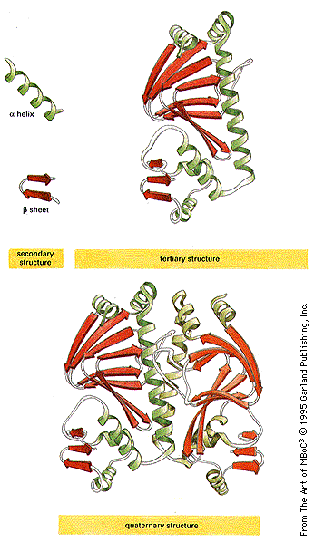
Proteins
primary structure: amino acid sequence
secondary structure: α-helix, β-sheets
tertiary structure: protein folding
quaternary structure: active sites

Slide 13
Proteins in action
Quaternary structure, active sites, active site dynamics
Linking to other proteins, metabolite molecules, ions
E.g., linking of sugar molecules and enzymes to produce energy storage molecules

Slide 14
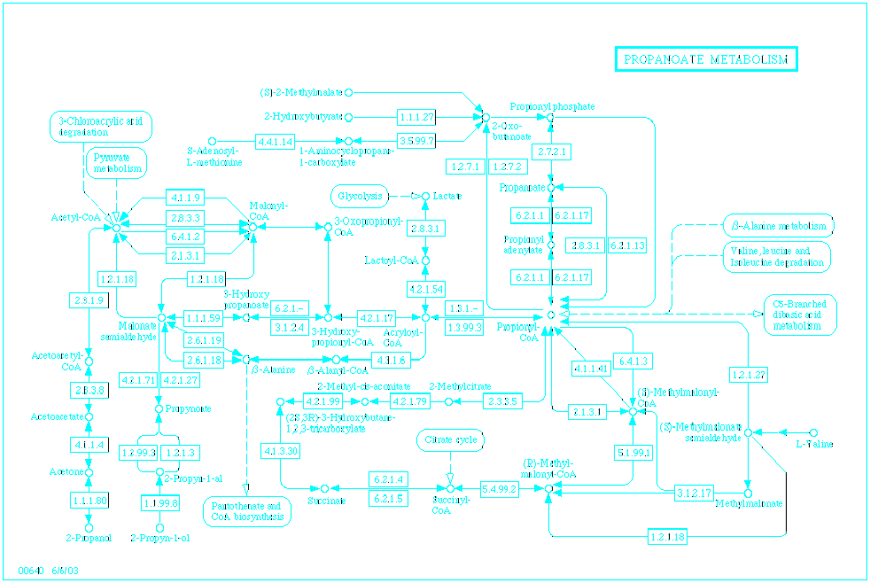
Protein interactions
Proteins form protein complexes and intermediary products
Enzyme proteins, functional cycles

Slide 15
Signalling pathways
Receptors are activated by outside molecules
Activated receptors trigger a series of interactions between proteins and proteins and metabolite molecules
E.g., neurotransmitter molecule links to receptor molecule, the linking triggers the opening of channel molecules

Slide 16
Communications in the cell
Spatio-temporal pattern of protein interactions
Communication units: proteins and other molecules
Communications: molecular interactions, primarily protein interactions
E.g., signaling pathways, cell wall synthesis

Slide 17
Referencing in the cell
Each interaction references other interactions by taking their products as parts of new interactions
E.g., functional cycles

Slide 18
The system boundary
Intense communications within the cell
Rare communications with the exterior of the cell (e.g., receptors linking to transmitters)
Boundary: cell membrane

Slide 19
Actions of the cell
Actions: sequence or pattern of communications:
that produce proteins incorporated in the cell membrane as receptors or signallers
that lead to the production of proteins and other compounds of cell secretions
that lead to the production of body movements of the cell
Actions are referenced by other communications within the cell

Slide 20
Perceptions of the cell
Receptors bind to messenger molecules
Ions and molecules enter the cell and interact with proteins of the cell
The results of perceptions are referenced by other cell communications

Slide 21
The cell as a system
Protein interaction communications about the cell – what is the cell and what is not the cell – definition of the cell’s identity
These interactions decide what can be incorporated into further communications of the cell (i.e., into proteins and cell metabolites) and what cannot serve for this purpose
The cell’s aim is the reproduction and expansion of itself

Slide 22
Meaningful and meaningless
Meaningful: sequence / pattern of protein interactions that lead to the incorporation / elimination into / from the cell of metabolites resulting new protein interactions
Meaningless: sequence / pattern of protein interactions that lead nowhere, i.e., the products of interactions cannot be part of cell communications, but they are not eliminated from the cell – they constitute identity violations of the cell

Slide 23
Antibiotics, toxins, prions
Antibiotics, toxins, prions generate interactions that lead to meaningless communications → faults and errors in the cell
I.e., they bind to proteins blocking their activity and stopping normal communications by forming products that cannot participate in these
Many meaningless communications reduce the communications within the cell and lead to the disintegration of the cell system → failure of the cell system

Slide 24
The language of the cell
The language units are sequences / patterns of protein and metabolite interactions
The grammar: the rules and the conditional probabilities of such sequences and patterns of interactions
Referencing rules: what interactions are required to produce the necessary ingredients for the production of a new interaction
Continuation rules: given a set of interactions what are the interactions that may be produced as continuation to them

Slide 25
Structures and subsystems of the cell
Structures – constraints on communications → constraints on referencing and continuation rules of protein interactions
Clusters of protein interactions satisfying additional constraints on protein interactions
Constraints: e.g. being inside of a vesicle, being bound to some other molecule
Such clusters may constitute cellular organelles or functional subsystems of protein interactions
E.g., respiration – mitochondria, movement – centrosome, digestion

Slide 26
Memories of protein interactions
mRNA molecules facilitate the reproduction of interactions between chains of amino acids and single amino acids during protein synthesis
mRNA molecules in one species may encode a combination of proteins that are encoded separately in other species
RNA molecules generate the appropriate combination of proteins within the cell to produce the right behaviour of the cell through protein interactions
RNA molecules can be seen as memories of protein interactions, which facilitate the reproduction of these interactions within the cell
See also result about gene correction in Arabidopsis supposed to be mediated by RNAs

Slide 27
RNA interactions
RNA molecules interact and regulate the production of proteins within the cell
siRNA, microRNA, other non-coding RNAs
Premature mRNA includes the mRNA and also other small RNAs that participate in RNA interactions
RNA interactions constitute a primary information subsystem of the cell → RNA world

Slide 28
Memories of RNA interactions
RNA molecules are produced by copying segments of the DNA
Premature mRNA – includes several RNAs, which may interact
Appropriate combinations of RNA molecules are produced from active parts of the DNA leading to appropriate regulation of protein production – segments of the DNA facilitate the reproduction of RNA interactions
DNA can be seen as memory of RNA interactions, and implicitly also as a memory of protein interactions

Slide 29
Memories of molecular interactions
mRNA: memory of protein interactions in a canonical manner: interactions of one amino acid with a string of amino acids
DNA gene segments: memory of RNAs and of RNA interactions: the transcribed premature mRNA includes short regulatory sequences that get spliced out and interact with other RNAs to produce the mature mRNA in a context dependent manner
Note: proteins are involved in RNA and DNA interactions – e.g. RNA polymerase, helicase, spliceosome proteins

Slide 30
The information subsystem
DNA segments, RNAs and proteins interact to regulate the dynamics of active parts of the DNA
These interactions between DNA segments and other molecules constitute the information subsystem of the cell
Genome: description of all proteins produced and used in the cell, regulating the appropriate production of them mediated by RNAs and RNA interactions
The genome is the information subsystem of the cell system
The genome defines the identity of the cell

Slide 31
Prokaryotes
Bacteria: no nucleus, less compacted genome
The information subsystem is there but is not yet organised as an integrated and well separated subsystem (i.e., it is organised in functional plasmids)
Large part (>75%) direct coding genome, relatively high level of interaction between the whole genome and the proteins of the cell

Slide 32
Eukaryotes
Cells with proper nucleus
Genome in the nucleus, surrounded by nuclear membrane
Separated information subsystem
Low proportion (even <5%) direct coding genome

Slide 33
Genome
A – adenin, C – cytosin, G – guanin, T – thymin
Coding / non-coding regulatory / junk segments
Organized into base pairs (AT, CG) and codons (triplets of base pairs) coding amino acids – phosphorylated sugar backbone

Slide 34
Gene regulation
Regulatory networks of genes and regulatory genome segments
Up and down regulation of the amount of proteins produced within the cell

Slide 35
Communications in the genome
Sequences and patterns of interacting / inter-regulating genes and regulatory segments
E.g., gene regulatory networks, topologically associating domains (TAD)

Slide 36
Referencing in the genome
New communications reference earlier / other regulatory actions

Slide 37
The system boundary
Intense regulatory interactions within the genome
Few interactions with the outside of the nucleus
Transcription factor proteins trigger cascades of DNA regulatory interactions turning on and off the production of series of proteins

Slide 38
Genome actions
Actions: production of mRNA, tRNA and other RNA molecules that are sent out into the cell to interact with proteins there
These processes are also referenced by further genome interactions

Slide 39
Genome perceptions
Perceptions: triggering the activity of genes and regulatory genome segments by proteins produced in the cell
These processes lead to the generation of new genome communications (e.g., cascades of turning on or off of genes and regulatory genome segments)

Slide 40
The genome as a system
Genome segment interaction communications about the identity of the cell
These interactions decide what is accepted as fitting to the identity of the cell and what is not (i.e., which coding segments of the genome should be active and produce mRNAs, tRNAs, and which should not)
The genome’s aim is its own maintenance and expansion

Slide 41
Genome expansion
Genome expansion: replication of the genome
Genome replication induces cell division → expansion of the cell
Multi-nuclear cells ?

Slide 42
System language in the genome
Language units: regulatory interactions of genome segments
Grammar: the rules of conditional continuation probabilities of such interactions
Referencing rules and continuation rules

Slide 43
Meaningful and meaningless
Meaningful: regulatory interactions that lead to continuation and to the production of RNAs and proteins that fit the identity of the cell and produce appropriate communications within the cell
Meaningless: interactions that don’t fit the identity of the cell and lead to meaningless communications within the cell (e.g., viral DNA, some mutated DNA) – faults and errors

Slide 44
Viruses
Pure DNA or RNA usually in lipo-peptide envelope possibly with attached sugars
Possibly: a cell memory alone in an optimised / simplified form which waits for the cell to incorporate it, so that it can multiply
They are usually meaningless in the host cell and some may cause cell death

Slide 45
Faults, errors and failure
Fault: communication that doesn’t fit the language – e.g. interactions of wrong proteins produced after antibiotic treatment of a bacterium, viral genome interactions
Error: lack of continuation communications – e.g. lack of expected protein interactions in an environment lacking critical nutrients
Failure: large scale contraction of the cell system due to faults and errors – e.g. effect of antibiotic on bacteria, radioactive damage to the genome

Slide 46
Adaptation – Cell
E.g. the nutrient environment of a bacterium changes; a neuron receives a certain pattern of spike input
Cell perception – difference between expectation and actual protein interactions – an error in the context of expectations
A new set of protein interactions is triggered aimed to remove the root of experienced identity violation – i.e. prevent the formation of unsatisfied expectation

Slide 47
Adaptation – Genome
Identity violations experienced by the cell system translate into identity violations experienced in the information subsystem of the cell
The information subsystem acts by identity revision communications in the form of generating RNAs that were not present in the previous moment in the cell leading to the production of new proteins and the adaptation of the cell’s protein interaction system
E.g. changing receptor and ion channel expression pattern in neurons in response to received stimuli

Slide 48
Adaptation of the genome
RNA mediated corrective adaptation of the genome in mutant Arabidopsis
Emergence of antibiotic resistant bacteria – identity revision by mutation and selection

Slide 49
Complexity of cells
Prokaryotes (bacteria) are simpler and produce low amount of biomass
Eukaryotes are more complex, having a differentiated and integrated cell information subsystem, and produce high amount of biomass

Slide 50
Complexity of the genome
Genomes with more regulatory and less coding parts are more complex as they model a larger part of their environment, producing better actions / perceptions

Slide 51
Summary – 1
Cell:
Communications: protein interactions
Cell system
Cell language
Action and perception
Meaning and meaningless
Structure and subsystems
Memory
Information subsystem

Slide 52
Summary – 2
Genome:
Communications
Language
Genome system
Action and perception
Meaning and meaningless
Complexity

Slide 53
Q&A – 1
Is it true that nucleic acids are part of proteins ?
Is it true that neurotransmitter molecules may become part of the cell system communications in neurons ?
Is it true that the secretion products of a cell are part of the cell system ?
Is it true that a prion may cause meaningless communications within a cell ?

Slide 54
Q&A – 2
5. Is it true that the change of active sites of a protein represents the effect of a communication reference in the cell system ?
6. Is it true that the penicillin may become part of a cell system if it contains penicillinase enzymes ?
7. Can we see the ion combination rules as part of the cell language grammar ?

Slide 55
Q&A – 3
Is it true that the genome is the information subsystem of the cell ?
Is it true that the generation of an mRNA is a result of referencing to other genome communications ?
Is it true that mRNAs represent the perceptions of the genome system ?
Is it true that the language of the genome system is defined by grammatical rules representing the conditional probabilities of genome communications ?

